Slide 1


Tech ABC Corp - HR Database
[Velavan Dhanavel & 26-Dec-2025]

Slide 2
Business Scenario
Business requirement
Tech ABC Corp saw explosive growth with a sudden appearance onto the gaming scene with their new AI-powered video game console. As a result, they have gone from a small 10 person operation to 200 employees and 5 locations in under a year. HR is having trouble keeping up with the growth, since they are still maintaining employee information in a spreadsheet. While that worked for ten employees, it has becoming increasingly cumbersome to manage as the company expands.
As such, the HR department has tasked you, as the new data architect, to design and build a database capable of managing their employee information.
Dataset
The HR dataset you will be working with is an Excel workbook which consists of 206 records, with eleven columns. The data is in human readable format, and has not been normalized at all. The data lists the names of employees at Tech ABC Corp as well as information such as job title, department, manager's name, hire date, start date, end date, work location, and salary.
IT Department Best Practices
The IT Department has certain Best Practices policies for databases you should follow, as detailed in the Best Practices document.

Slide 3
Step 1
Data Architecture Foundations

Slide 4
Step 1: Data Architecture Foundations
Hi,
Welcome to Tech ABC Corp. We are excited to have some new talent onboard. As you may already know, Tech ABC Corp has recently experienced a lot of growth. Our AI powered video game console WOPR has been hugely successful and as a result, our company has grown from 10 employees to 200 in only 6 months (and we are projecting a 20% growth a year for the next 5 years). We have also grown from our Dallas, Texas office, to 4 other locations nationwide: New York City, NY, San Francisco, CA, Minneapolis, MN, and Nashville, TN.
While this growth is great, it is really starting to put a strain on our record keeping in HR. We currently maintain all employee information on a shared spreadsheet. When HR consisted of only myself, managing everyone on an Excel spreadsheet was simple, but now that it is a shared document I am having serious reservations about data integrity and data security. If the wrong person got their hands on the HR file, they would see the salaries of every employee in the company, all the way up to the president.
After speaking with Jacob Lauber, the manager of IT, he suggested I put in a request to have my HR Excel file converted into a database. He suggested I reach out to you as I am told you have experience in designing and building databases. When you are building this, please keep in mind that I want any employee with a domain login to be have read only access the database. I just don't want them having access to salary information. That needs to be restricted to HR and management level employees only. Management and HR employees should also be the only ones with write access. By our current estimates, 90% of users will be read only.
I also want to make sure you know that am looking to turn my spreadsheet into a live database, one I can input and edit information into. I am not really concerned with reporting capabilities at the moment. Since we are working with employee data we are required by federal regulations to maintain this data for at least 7 years; additionally, since this is considered business critical data, we need to make sure it gets backed up properly.
As a final consideration. We would like to be able to connect with the payroll department's system in the future. They maintain employee attendance and paid time off information. It would be nice if the two systems could interface in the future
I am looking forward to working with you and seeing what kind of database you design for us.
Thanks,
Sarah Collins
Head of HR

Slide 5
Data Architect Business Requirement
Purpose of the new database:
To design and build a new HR Database for handling Tech ABC Corp’s employee information.
Describe current data management solution:
Currently, the HR dataset is stored in a shared Excel workbook. This is okay for small scale operation with single or limited user access. However, it would be hard to maintain with multi user access and does not provide the level of data integrity, security and scalability that a database system provides.
Describe current data available:
  The business currently has the following employee information in the spreadsheet:
  Employee name, Job title, Department, Manager's name, Hire date, Start date, End date, Work location, and Salary.

Slide 6
Data Architect Business Requirement (contd)
Additional data requests:
To ensure long-term data retention (for at least 7 years)
To build reliable backups considering criticality of the data.
Who will own/manage data
HR Department will own/manage data.
Who will have access to database
Write Access: Only HR and Management will have write access to database
Read Access: All employees with domain login will have read-only access to data except for salary information.
Restricted Access: Salary information will be restricted to HR and Management level employees only. Domain level employees won’t be able to access Salary data.

Slide 7
Data Architect Business Requirement
Estimated size of database
Number of Employee records now: 200
Projected Growth per year: 20% growth per Year
Projected Growth in 5 to 7 Years: 498 to 717 employee records.
Estimated annual growth
Business is expecting 20% growth a year for the next 5 years
Is any of the data sensitive/restricted
Yes, employee salary information should be accessible only to HR and Management.
Read-Only access to all domain users, except for Salary data.

Slide 8
Data Architect Technical Requirement
Justification for the new database
Migrating from an excel spreadsheet to a Relational Database provides robustness, concurrency and data security.
Supports multi-user role based user access.
Enables long term data retention and provides reliable backup.
Ensures scalability and enables future integration.
Database objects
List the database objects (tables, views, special procedures) that will be created for the database.
Tables:
EMPLOYEE EMPLOYMENT JOB SALARY DEPARTMENT LOCATION ADDRESS EDUCATION

Slide 9
Data Architect Technical Requirement (contd…)
Raw data staging table:
HR_DATASET_RAW
View:
HR_DATASET

Slide 10
Data ingestion
Select a data ingestion method (ETL, Direct feed, API) based on the information provided.
ETL is the suitable data ingestion method for this requirement. Below steps are the high-level approach for the data ingestion.
Step 1: Convert the HR-Dataset.xlsx Excel to CSV format for loading data into PostgreSQL database
Step 2: Create a Staging table to hold the raw data from HR-Dataset.csv file.
Step 3: Use the \copy command to copy the HR_Dataset file data into Raw table in stage schema.
Step 4: Insert data from staging table to Target tables listed in ER diagram.
\copy STG_SCHEMA.HR_DATASET_RAW FROM 'C:\Learning\Udacity - DA\hr-dataset.csv' CSV HEADER;

Slide 11
Data Architect Technical Requirement
Data governance (Ownership and User access)
Ownership: who will own and maintain the data
HR will own the data.
User Access: who will and will not have access to the data
Note:
Write Access: Only HR and Management will have write access to database
Read Access: All employees with domain login will have read-only access to data except for salary information.
Restricted Access: Salary information will be restricted to HR and Management level employees only. Domain level employees won’t be able to access Salary data.
User Role | User Type | Access Restrictions
HR_USER | HR and Management level Users | Write Access to all data. Read Access to all data including Salary Information.
DOMAIN_USER | Domain level Employees | Read only access. No read access to Salary information

Slide 12
Scalability
Replication or sharding to be used to ensure scalability based on user needs
Replication should be done to avoid data loss or to enable high availability.
Sharding may not be required for this database as the estimated volume do not exceed beyond few thousands of rows.
Flexibility
Describe measures taken to ensure future data integration if needed
This HR Database has been designed in 3NF which ensures the following:
Every entity is isolated as per the normalization rules.
New entities to be added to the database can be linked via corresponding foreign keys.
New attributes can be added as needed to the appropriate table without impacting other tables.
Future data integration can be done without breaking the existing setup or requiring major re-design.

Slide 13
Storage & retention
Storage (disk or in-memory): check IT best practices document
Retention: 7 Years or more.
Backup
IT Best Practices document lists Backup schedule requirements

Slide 14
Step 2
Relational Database Design

Slide 15
Step 2: Relational Database Design
This step is where you will go through the process of designing a new database for Tech ABC Corp's HR department. Using the dataset provided, along with the requirements gathered in step one, you are going to develop a relational database set to the 3NF.
Using Lucidchart, you will create 3 entity relationship diagrams (ERDs) to show how you developed the final design for your data.
You will submit a screenshot for each of the 3 ERDs you create. You will find detailed instructions for developing each of the ERDs over the next several pages.

Slide 16
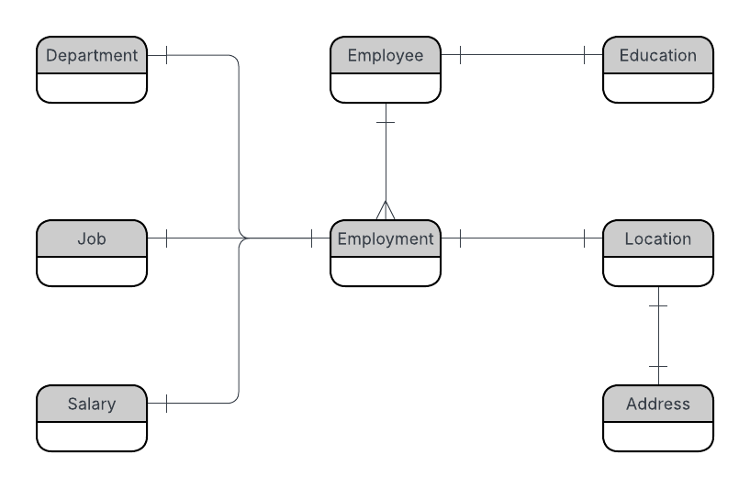
ERD
Conceptual
This is the most general level of data modeling. At the conceptual level, you should be thinking about creating entities that represent business objects for the database. Think broadly here. Attributes (or column names) are not required at this point, but relationship lines are required (although Crow's foot notation is not needed at this level). Create at least three entities for this model; thinking about the 3NF will aid you in deciding the type of entities to create.
Use Lucidchart’s built-in template for DBMS ER Diagram UML.

Slide 17
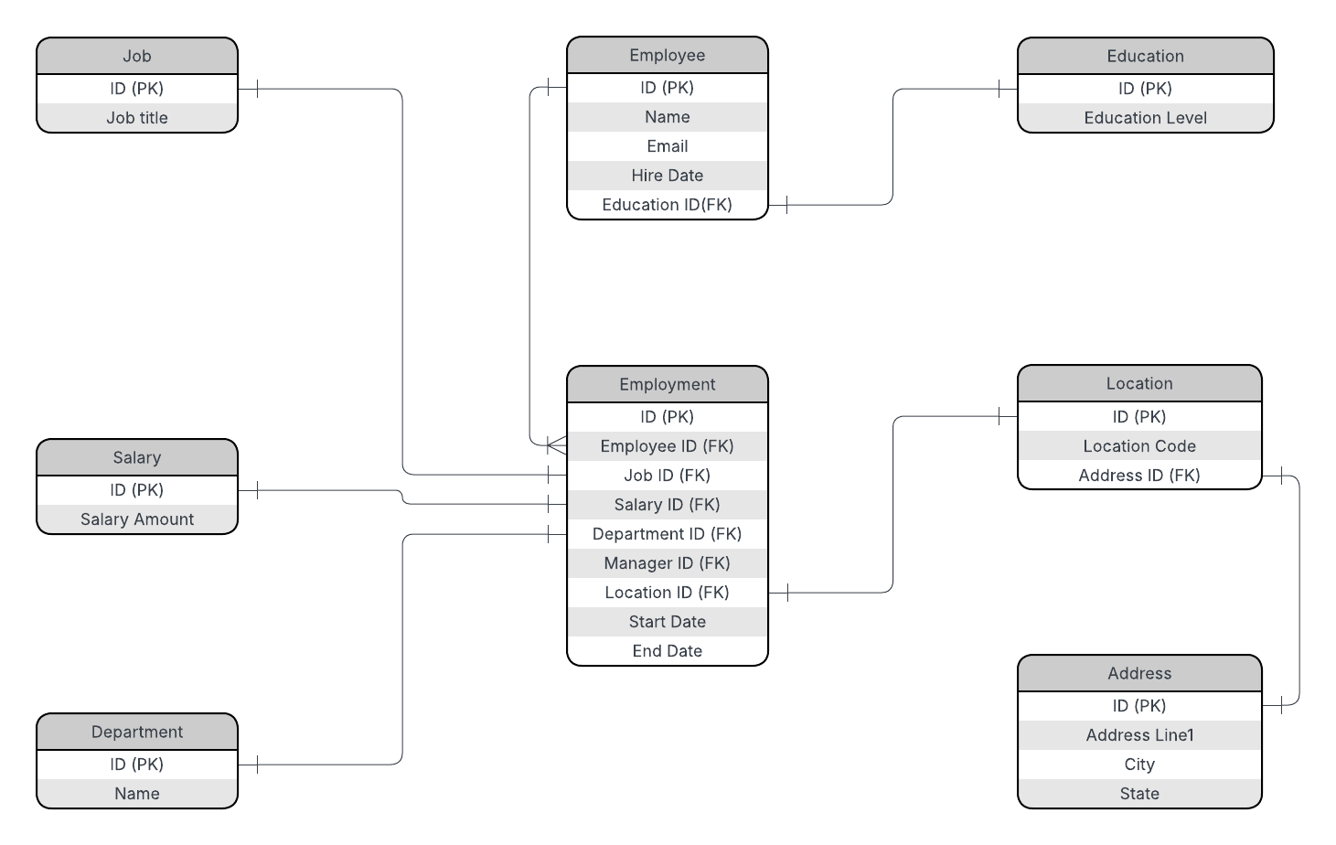
ERD
Logical
The logical model is the next level of refinement from the conceptual ERD. At this point, you should have normalized the data to the 3NF. Attributes should also be listed now in the ERD. You can still use human-friendly entity and attribute names in the logical model, and while relationship lines are required, Crow's foot notation is still not needed at this point.
Use Lucidchart’s built-in template for DBMS ER Diagram UML.

Slide 18
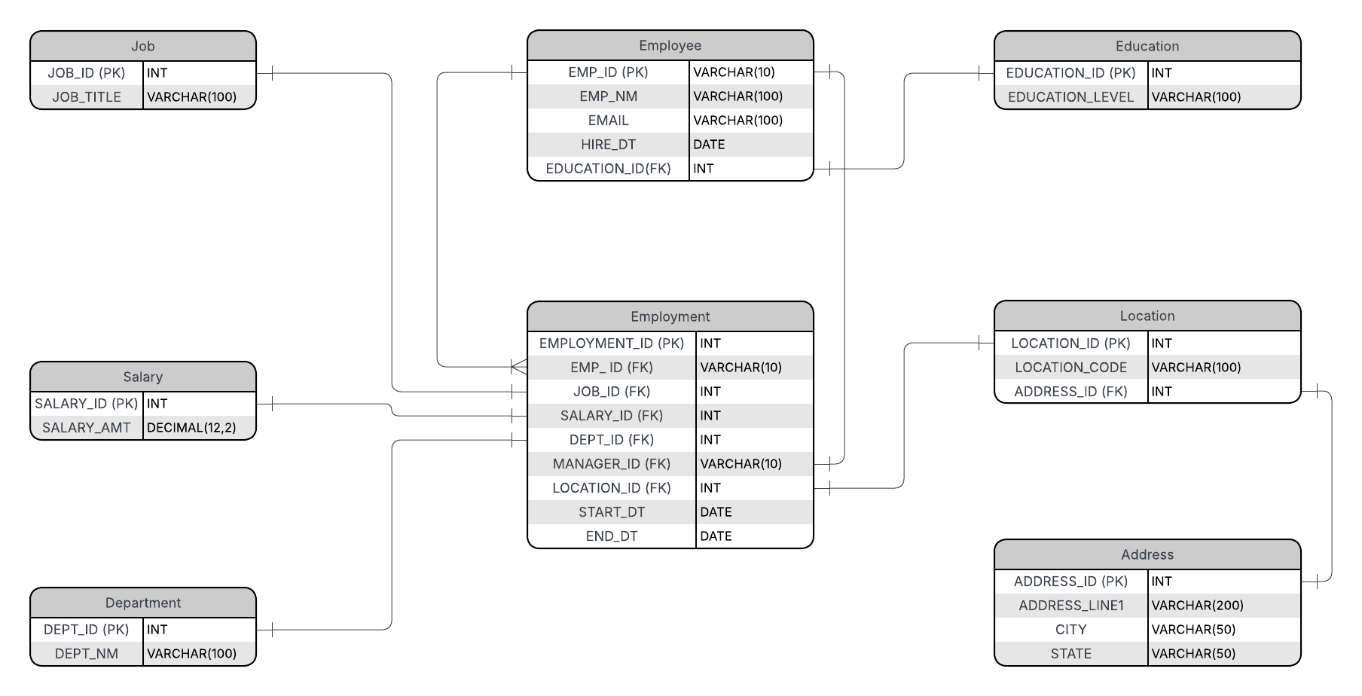
ERD
Physical
The physical model is what will be built in the database. Each entity should represent a database table, complete with column names and data types. Primary keys and foreign keys should also be represented here. Primary keys should be in bold type with the (PK) designation following the field name. Foreign keys should be in normal type face, but have the designation (FK) after the column name. Finally, in the physical model, Crow's foot notation is important.

Slide 19
Step 3
Create A Physical Database

Slide 20
Step 3: Create A Physical Database
In this step, you will be turning your database model into a physical database.
You will:
Create the database using SQL DDL commands
Load the data into your database, utilizing flat file ETL
Answer a series of questions using CRUD SQL commands to demonstrate your database was created and populated correctly
Submission
For this step, you will need to submit SQL files containing all DDL SQL scripts used to create the database.
You will also have to submit screenshots showing CRUD commands, along with results for each of the questions found in the starter template.
Hints
Your DDL script will be graded by running the code you submit. Please ensure your SQL code runs properly!
Foreign keys cannot be created on tables that do not exist yet, so it may be easier to create all tables in the database, then to go back and run modify statements on the tables to create foreign key constraints.
After running CRUD commands like update, insert, or delete, run a SELECT* command on the affected table, so the reviewer can see the results of the command.

Slide 21
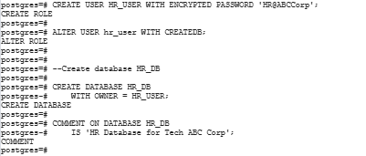
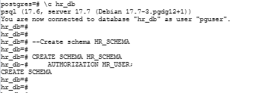
DDL
Create a DDL SQL script capable of building the database you designed in Step 2
DDL Script : https://github.com/its-developer-hub/HR-Database-in-PostgreSQL/blob/main/SQL_Scripts/DDL_Scripts.sql
Create User & DB:
Connect to HR_DB and create schema:

Slide 22




DDL _{(contd…)}
Create Tables:
Job:
Salary:
Department:
Education:

Slide 23


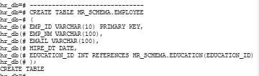
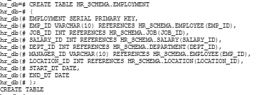
DDL _{(contd…)}
Address:
Location:
Employee:
Employment:

Slide 24
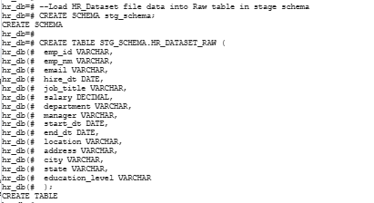
DDL for Stg table to store raw HR-Dataset.csv file
Follow the below steps to load data from HR-Dataset file to Staging table.
Step 1: Convert the HR-Dataset.xlsx Excel to CSV format for loading data into PostgreSQL database. Since this is a comma separted file, remove any comma within a field value. Below is the csv format converted file which has been used to load the raw data into HR_DB.
  HR-Dataset.csv file: https://github.com/its-developer-hub/HR-Database-in-PostgreSQL/blob/main/Raw_Data/hr-dataset.csv
Step 2: Create a Staging table to hold the raw data from HR-Dataset.csv file.

Slide 25
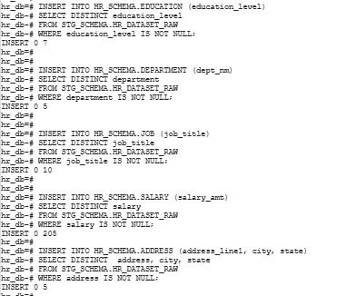
DML
Step 3: Use the \copy command to copy the HR_Dataset file data into Raw table in stage schema.
Step 4: Insert data from staging table to Target tables listed in ER diagram.

Slide 26
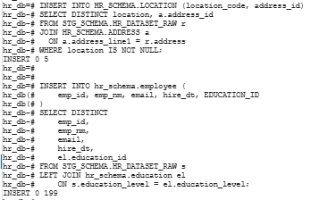
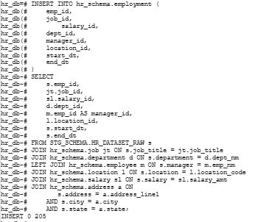
DML
Step 4: (Contd..)

Slide 27
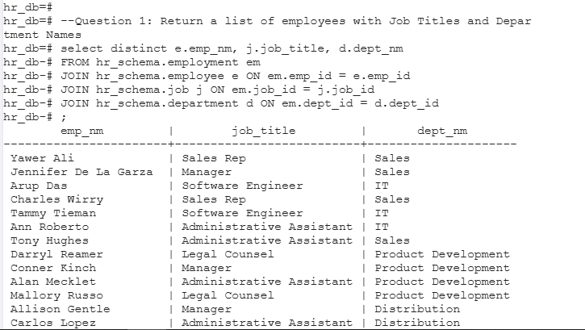
CRUD
Question 1: Return a list of employees with Job Titles and Department Names
Query:
select distinct e.emp_nm, j.job_title, d.dept_nm FROM hr_schema.employment em JOIN hr_schema.employee e ON em.emp_id = e.emp_id JOIN hr_schema.job j ON em.job_id = j.job_id JOIN hr_schema.department d ON em.dept_id = d.dept_id ;

Slide 28
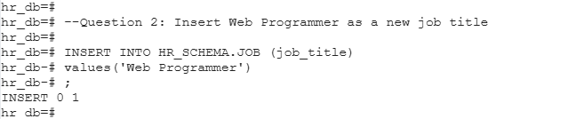

CRUD
Question 2: Insert Web Programmer as a new job title
Query:
  Run the below select statement to confirm
INSERT INTO HR_SCHEMA.JOB (job_title) values('Web Programmer') ;

Slide 29
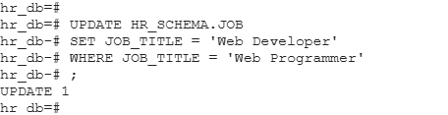

CRUD
Question 3: Correct the job title from web programmer to web developer
Query:
  Run the below select statement to confirm
UPDATE HR_SCHEMA.JOB SET JOB_TITLE = 'Web Developer' WHERE JOB_TITLE = 'Web Programmer' ;

Slide 30


CRUD
Question 4: Delete the job title Web Developer from the database
Query:
  Run the below select statement to confirm
DELETE FROM HR_SCHEMA.JOB WHERE JOB_TITLE = 'Web Developer' ;

Slide 31
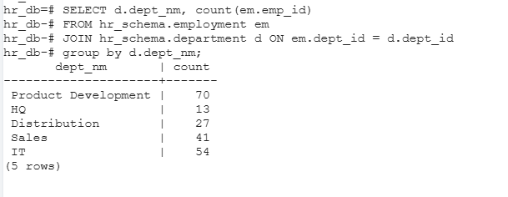
CRUD
Question 5: How many employees are in each department?
Query:
SELECT d.dept_nm, count(em.emp_id) FROM hr_schema.employment em JOIN hr_schema.department d ON em.dept_id = d.dept_id group by d.dept_nm;

Slide 32
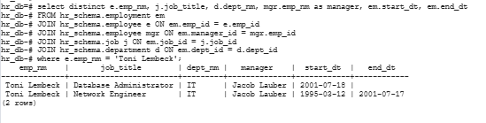
CRUD
Question 6: Write a query that returns current and past jobs (include employee name, job title, department, manager name, start and end date for position) for employee Toni Lembeck.
Query:
select distinct e.emp_nm, j.job_title, d.dept_nm, mgr.emp_nm as manager, em.start_dt, em.end_dt FROM hr_schema.employment em JOIN hr_schema.employee e ON em.emp_id = e.emp_id JOIN hr_schema.employee mgr ON em.manager_id = mgr.emp_id JOIN hr_schema.job j ON em.job_id = j.job_id JOIN hr_schema.department d ON em.dept_id = d.dept_id where e.emp_nm = 'Toni Lembeck';

Slide 33
CRUD
Question 7: Describe how you would apply table security to restrict access to employee salaries using an SQL server.
Grant read access to all tables in the schema to all employees(domain level users).
Then Revoke read access to Salary table to Employees.
Sample Query:
GRANT USAGE ON SCHEMA hr_schema TO DomainUser; GRANT SELECT ON ALL TABLES IN SCHEMA hr_schema TO DomainUser; REVOKE SELECT ON hr_schema.salary FROM DomainUser;

Slide 34
Step 4
Above and Beyond (optional)

Slide 35
Step 4: Above and Beyond
This last step is called Above and Beyond. In this step, I have proposed 3 challenges for you to complete, which are above and beyond the scope of the project. This is a chance to flex your coding muscles and show everyone how good you really are.
These challenge steps will bring your project even more in line with a real-world project, as these are the kind of “finishing touches” that will make your database more usable. Imagine building a car without air conditioning or turn signals. Sure, it will work, but who would want to drive it.
I encourage you to take on these challenges in this course and any future courses you take. I designed these challenges to be a challenge to your current abilities, but I ensured they are not an unattainable challenge. Remember, these challenges are completely optional - you can pass the project by doing none of them, or just some of them, but I encourage you to at least attempt them!

Slide 36
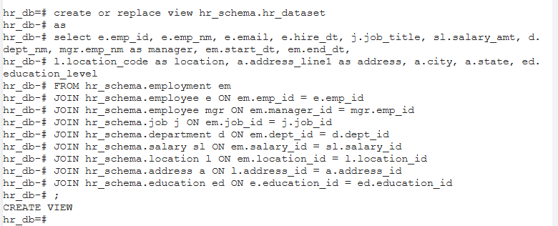
Standout Suggestion 1
Create a view that returns all employee attributes; results should resemble initial Excel file
The SQL script for this code is present in the below git file.
https://github.com/its-developer-hub/HR-Database-in-PostgreSQL/blob/main/SQL_Scripts/Standout_suggestion1_scripts.sql

Slide 37
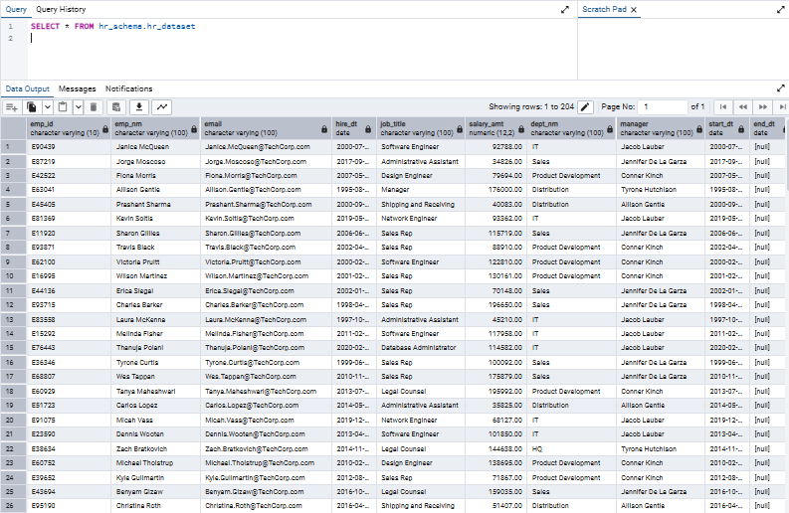
Standout Suggestion 1(Contd…)
Resultset:

Slide 38
Standout Suggestion 2
Create a stored procedure with parameters that returns current and past jobs (include employee name, job title, department, manager name, start and end date for position) when given an employee name.
** submit screenshot of stored procedure creation code, along with a screenshot of the stored procedure executed using Toni Lembeck as the parameter value
<skipped>

Slide 39
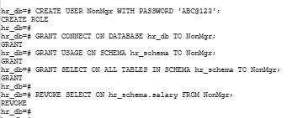
Standout Suggestion 3
Implement user security on the restricted salary attribute.
Create a non-management user named NonMgr. Show the code of how your would grant access to the database, but revoke access to the salary data.
Script:
CREATE USER NonMgr WITH PASSWORD 'ABC@123'; GRANT CONNECT ON DATABASE hr_db TO NonMgr; GRANT USAGE ON SCHEMA hr_schema TO NonMgr; GRANT SELECT ON ALL TABLES IN SCHEMA hr_schema TO NonMgr; REVOKE SELECT ON hr_schema.salary FROM NonMgr;

Slide 40
Appendix

Slide 41
Additional Info
Github Repository:
All SQL scripts are available in the below Github repository.
https://github.com/its-developer-hub/HR-Database-in-PostgreSQL.git
Lucid Chart – ER Diagrams:
https://lucid.app/lucidchart/f8bf1864-18f0-4b8c-b086-899c808ec23f/edit?invitationId=inv_3f202787-7206-4507-ba54-ac994db8102e
HR-Dataset.csv file:
https://github.com/its-developer-hub/HR-Database-in-PostgreSQL/blob/main/Raw_Data/hr-dataset.csv
Best Practices document:
IT Best Practices document

